Slide 1
Zerodha Business Model Fintech Start-up
By- Shantanu Bhute
24201796

Slide 2
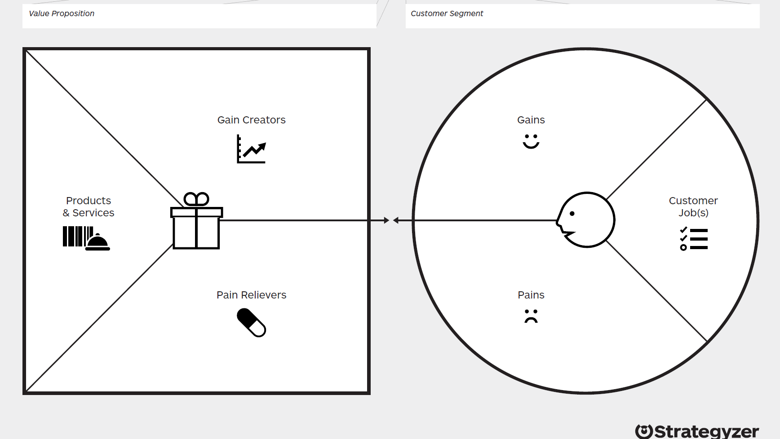
Cost efficiency
Direct investments
Zerodha Kite
Reliable platform
Transparent pricing
Advanced trading features
Zerodha Streak
Financial education
Low
costs
Trading & investing
Advanced tools
Zerodha Rainmatter
Access trading tools
Support for fintech growth
Educational content
Portfolio management
Flat fees
Market tracking
Tech glitches
Kite Connect API
Transparent charges
High fees
Financial education
Zerodha Varsity
Hidden charges
Comprehensive support
User-friendly tech
Zerodha Coin
Poor support
Complex platforms
Educational modules
24/7 availability

Slide 3
Indian stock exchanges
Tech development of platforms
Affordable trading with transparent pricing.
Professional support for portfolio management.
Retail investors and first-time traders in India.
Regulatory bodies (e.g., SEBI) for legal compliance.
24/7 online support
Customer support and marketing for acquisition.
User-friendly platform with advanced features (Kite)
Experienced traders needing advanced tools
Clearing corporations for trade settlement.
Active social media for updates and engagement.
Regulatory compliance
Commission-free mutual fund investments (Coin).
New investors seeking educational support.
Banks for smooth fund transactions.
Interactive Community
Educational resources for all investor levels (Varsity)
Tech enthusiasts building custom apps via APIs.
Payment gateways for seamless fund transfers.
Zerodha website and mobile apps (Kite, Coin)
Proprietary trading software
Algo trading and strategy backtesting tools (Streak).
Institutional clients and high-net-worth individuals (HNIs)..
Educational partners for investor training.
Online forums & webinars
IT & security infrastructure
Support for fintech startups (Rainmatter).
Fintech startups under the Rainmatter initiative to foster innovation.
Skilled development team and strong brand equity.
Web Application Sign-in
Corporate clients seeking trading solutions and partnerships.
Reliable trading with real-time data.
Partnerships with financial blogs.
Platform R&D and maintenance.
Salaries and operational costs for tech and support teams
Flat-fee trading charges for stocks and commodities.
Subscription fees for premium tools
(e.g. Streak).
Marketing, promotions, and PR.
Legal, compliance, licensing fees, and infrastructure costs (servers, cybersecurity).
Account maintenance and annual transaction fees.
Partner commissions from API integrations (Kite Connect) and interest income from idle trading account funds.
Real-time data service expenses.

Slide 4
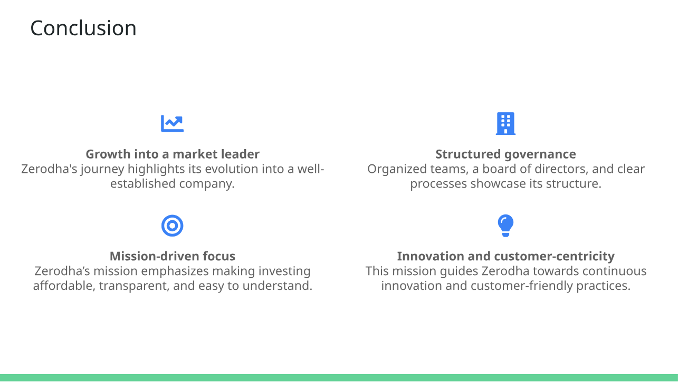

Slide 5

Thank You

